Slide 1
ER to Relational Model
Mapping Rules

Slide 2
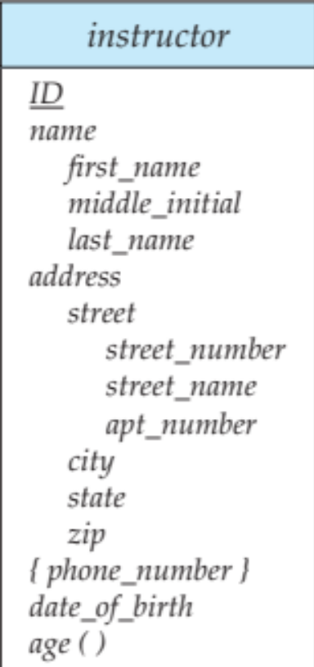
Step 1 : Entity
From entity to relation/table
Create a new relation that includes all the attributes
Leave out multi-valued attributes (if any)
Pick up appropriate PK

Slide 3
Instructor DDL
CREATE TABLE Instructor
        (I_ID CHAR(20)
        name CHAR(20),
        dept_name CHAR(10),
        salary (INTEGER)
PRIMARY KEY (I_ID) )

Slide 4
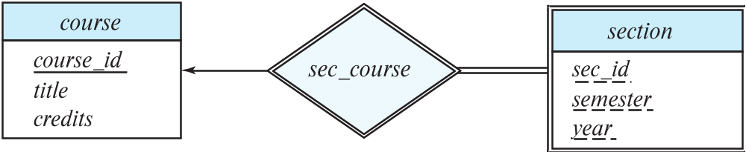
Step 2 : Weak Entity
Create a new relation
Include all attributes
Include FK pointing towards owner relation
Example: adding ‘C_ID’ to the ‘section’ relation
PK is the combination of the FK and the partial key
Section( C_ID, Sec_ID, semester, year, building, room_number)

Slide 5
Weak Entity sets
Weak entity set (section) and identifying relationship set (course) are translated into a single table Section_sec_course
When the owner entity is deleted, all owned weak entities must also be deleted.
CREATE TABLE Section_Sec_course (
Sec_ID CHAR(20),
Semester CHAR (20),
Year CHAR (20),
Building CHAR(20),
Room number INTEGER,
C_ID INTERGER NOT NULL,
PRIMARY KEY (sec_ID, semester, year, C_ID),
FOREIGN KEY (C_ID) REFERENCES Course,
ON DELETE CASCADE)

Slide 6
Step 3 : 1:1 Relationship
Add to one of the participating relation a FK to other relation
It is better to add to the relation that has a total participation in the relationship
Include any relationship attributes
Example: consider instructor-advisor-student
Every student has at most one advisor and an instructor advises at most one student
Stu_advisor ( s_ID, s_name, dept_name, tot_credit, I_ID, since)
Foreign Key I_ID references to Instructor

Slide 7
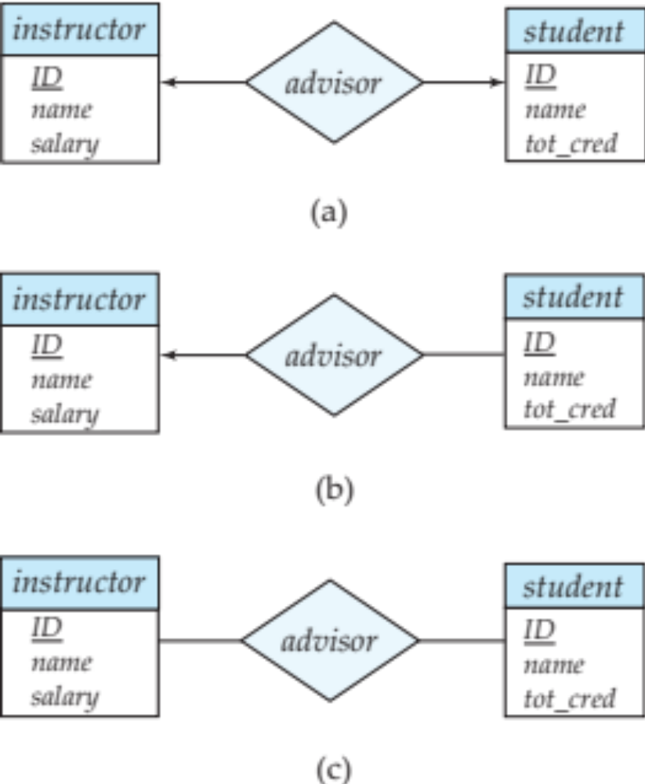
Every student must have an advisor

Slide 8
Step 4 : 1:N Relationship
Add to the relation a FK from the other side
Include any relationship attributes
Example: instructor-advisor-student
1:N
Add to student relation I_ID
Add attribute since
Student ( S_ID, S_name, dept_name, total_cred, I_ID, since)
  FK (I_ID) references Instructor

Slide 9
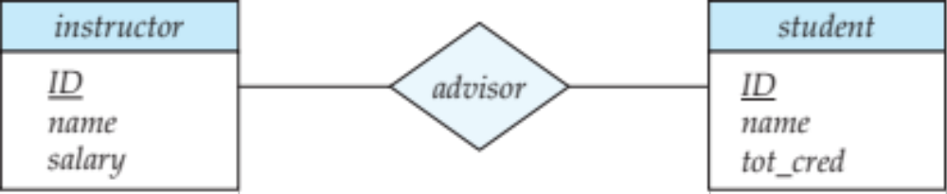
Step 5 : M:N Relationship
Create a new relation containing FKs to both the participating relations
Add relationship attributes (since)
PK is the combination of both the FKs
Instructor-advisor-student
student can have many advisors and instructor can advise many students
Advisor( I_ID, S_ID, since)

Slide 10
Step 6 : Multivalued Attributes
Create a new relation
  containing FK to the entity containing it
  Attribute or attributes
PK is FK plus the attributes
Instructor (I_ID, Name, Dept_name, salary, {phone_no})
Inst_ph ( I_ID, ph_no)
It is all key relation
FK (I_ID) references Instructor)

Slide 11
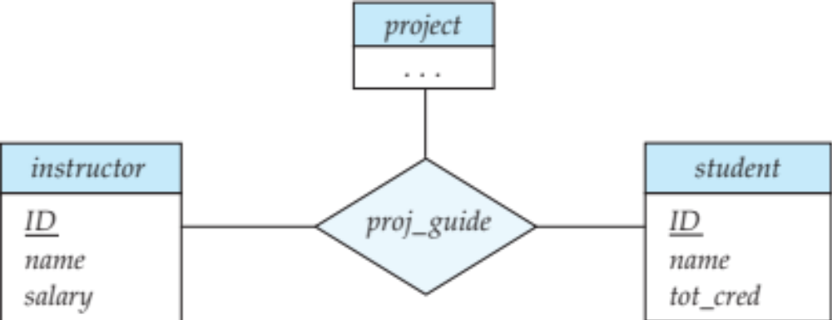
Step 7 : Ternary Relationship
New relation containing a foreign key referencing each of the 3 entities
Include relationship/descriptive attributes (if any)
Proj_guide ( instructor, project, student)
Proj_guide has descriptive attribute (since)
Proj_guide ( I_ID, P_ID, S_ID, since)

